Slide 1

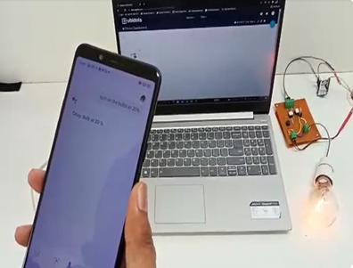
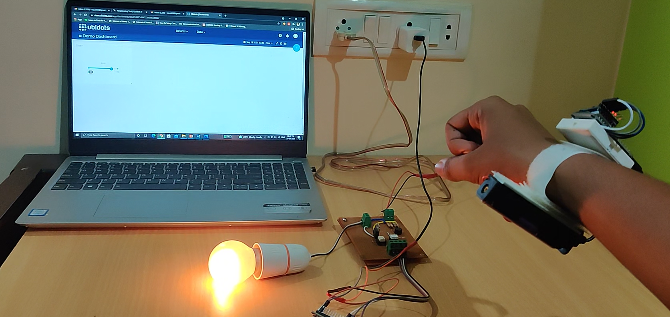
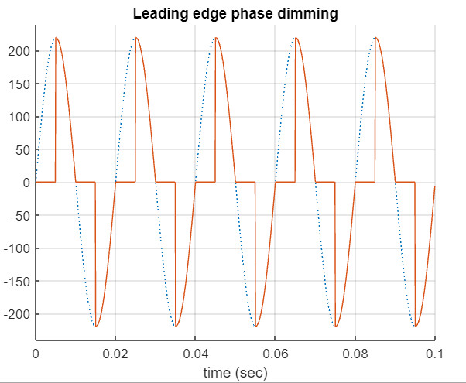
INTENSITY CONTROL OF HOME APPLIANCES
USING MQTT PROTOCOL
ROHAN N, AKHIL V, ROSHAN N, MRIDHULA S,
PROJECT GUIDE: DR. ANURADHA M
MOTIVATION
THEORY
ANALYSIS
Develop a wrist band to control devices.
Make it self-regulating for
Physically handicapped and old people.
To make it relatively affordable, simple to implement and users friendly.
Leading edge phase dimming method and MQTT protocol was used to complete the project.
The MQTT protocol has 3 entities: broker, publisher and the subscriber and we are able to control the intensity of home appliances using this method.
The subscriber circuit is divided into two parts Zero crossing detecting circuit and phase/angle control using triac.
The output of the circuit shows that there is power as the power is provided only for certain amount of time.
IMPLEMENTATION
Various input methods such as voice using google assistant, slide bar using ubidots server and based on our gesture with the help of an accelerometer.
Includes a smart band which helps in controlling the intensities of devices taking hand gestures as input.
MQTT protocol is used as the communication protocol in this model.
The values from the wristband and google assistant which are the publisher is sent to the MQTT broker.
The MQTT broker then sends the value to the subscriber. circuit
RESULT AND CONCLUSION
Proposes an innovative way to control Home Appliance.
The advantage of the proposed method is scalability and it’s a low-cost solution.
As a result of this approach, there is power saving.
Future Scope, apply this into smartwatch and failsafe system.

